Slide 1
EPSY 5244: Survey Design, Sampling, and Implementation
Wenchao Ma
University of Minnesota

Slide 2
Reading materials
Dillman, D. A., Smyth, J. D., & Christian, L. M. (2014). Internet, Phone, Mail, and Mixed‐Mode Surveys: The Tailored Design Method. Wiley. Chapters 4-7.

Slide 3
Thinking About the Respondent’s Perspective
The underlying principle behind the best practices and guidelines for successful surveys is that the surveyor must get into a “respondent state of mind”
We must consider what the questions, questionnaire, contacts, and so on will look like from the respondent’s perspective

Slide 4
Issues to Consider When Starting to Craft Survey Questions
1. What concepts do I need to measure?
Start by writing clear research questions that identify what will be studied
2. What type of information is the question asking for?
Some information is readily available for respondents (e.g., demographics) whereas other types require respondents to think and/or recall (e.g., attitudes or behaviors) and are influenced by the context in which the question is asked
Questions need to be designed so that they are not too difficult to answer and don’t require respondents to recall details that are too specific

Slide 5
How many times have you read a magazine in the last six months?

Slide 6
Issues to Consider When Starting to Craft Survey Questions
3. What survey mode(s) will be used to ask the questions?
Each mode has features that can enable some designs and constrain others:
Presence versus absence of an interviewer
Interviewer can provide extra motivation and assistance
But also may introduce interviewer variance and various forms of interviewer bias: social desirability, acquiescence, or when interviewer characteristics affect how people respond

Slide 7
Issues to Consider When Starting to Craft Survey Questions
4. Is the question being repeated from another survey, and/or will answers be compared to previously collected data?
Consistency in how questions are asked is important for comparison
5. Will respondents be willing and motivated to answer accurately?
Think through the process respondents go through to help identify where things can go wrong

Slide 8
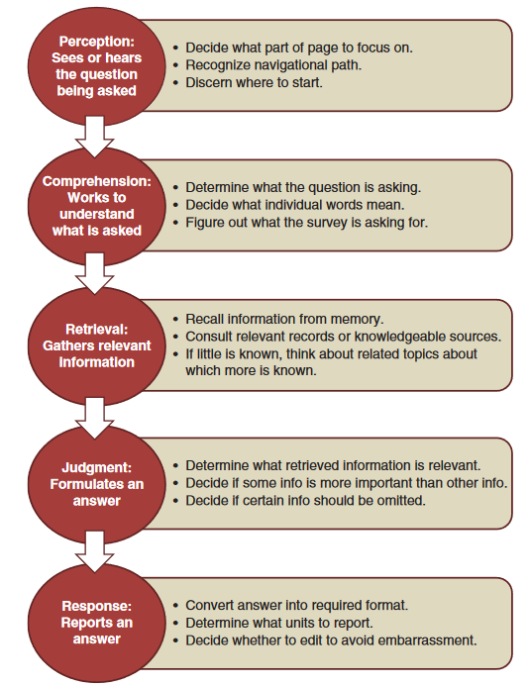
A common model of the survey response process
We want respondents to optimize: doing all the necessary mental work to provide quality answers, rather than satisfice: shortcut the response process

Slide 9
Approaches To Item Writing
Start from scratch - brainstorm
Engage w/potential respondents or experts
Use or adapt existing measures
Useful when no existing measures are available
Focus groups
Interviews
Literature
Most efficient (if possible)
Can not re-use psychometric properties!

Slide 10
Anatomy of a Survey Question
Vocabulary note: “item” vs. “question”
Item is a more general term – we are not always asking direct questions
Question stem: the words that form the actual query itself
Additional instructions: definitions or examples that will help respondents comprehend the meaning of the question or key concepts, or directions to further inform respondents how to respond
Answer spaces or choices: where respondents report their response

Slide 11
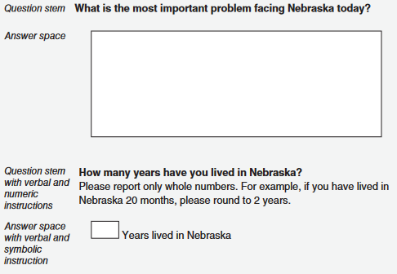
Types of Question Formats
Open-ended: allow respondents to formulate their answers how they want; offer a blank space or box where respondents write or type their own words (in self-administered surveys)
Should be used to collect rich, detailed information, or when little is known about the topic in advance
But require more work to analyze
And respondents are more likely to skip them

Slide 12
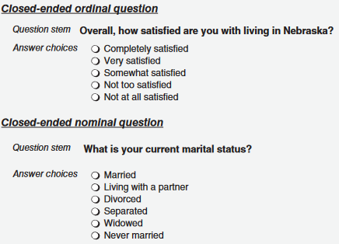
Types of Question Formats
Closed-ended: respondents are provided with a list of answer choices from which they must choose a response
Important to ensure that all reasonable responses are offered
Notes:
Nominal closed-ended: provide a set of categories that have no underlying, natural order; respondents must process and compare each
Ordinal closed-ended: provide a set of ordered answer categories, and respondents decide where they fit along a continuum
Partially closed-ended: hybrid of open- and closed-ended formats that includes a set of response categories and an “other” response that allows respondents to specify a different, unlisted category

Slide 13
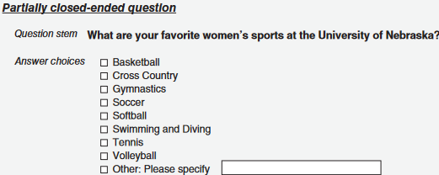
Types of Question Formats
Closed-ended: respondents are provided with a list of answer choices from which they must choose a response
Important to ensure that all reasonable responses are offered
Notes:
Nominal closed-ended: provide a set of categories that have no underlying, natural order; respondents must process and compare each
Ordinal closed-ended: provide a set of ordered answer categories, and respondents decide where they fit along a continuum
Partially closed-ended: hybrid of open- and closed-ended formats that includes a set of response categories and an “other” response that allows respondents to specify a different, unlisted category

Slide 14
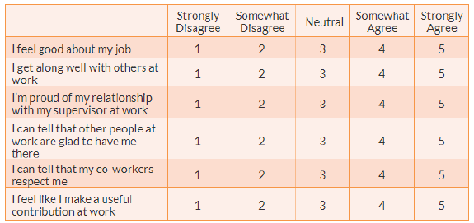
Types of Question Formats
Likert scale: When a Likert scale is used, the item is presented as a declarative sentence, followed by response options that indicate varying degrees of agreement with or endorsement of the statement.

Slide 15
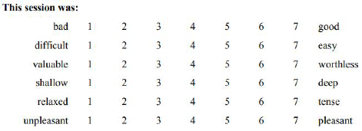
Types of Question Formats
Semantic Differential scale is also called bipolar adjective rating scale. Respondents are asked to indicate their opinions or feelings toward a single statement using different pairs of adjectives framed as polar opposites (Bhattacherjee, 2012)

Slide 16
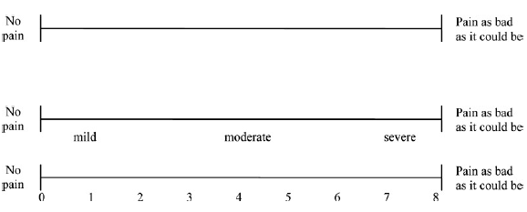
Types of Question Formats
Visual Analog scale presents the respondent with a continuous line between a pair of descriptors representing opposite ends of a continuum.
If descriptive terms like ‘mild’, ‘moderate’, ‘severe’ or a numerical scale is added, it is called graphic rating scale.

Slide 17

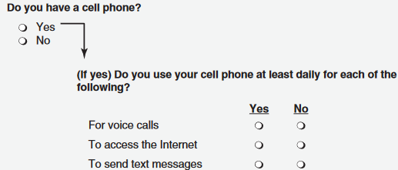
Make sure the question applies to the respondent
Every question should require an answer from every person of whom it is asked

Slide 18
Ask one question at a time
Sometimes questions ask two (or more) things at a time
Called “Double-barreled” questions
An easy mistake because we often want to limit the number of questions we ask in a survey
Has the district been responsive to your customer service needs with timely, informative, and accurate information?
Yes Sometimes No

Slide 19
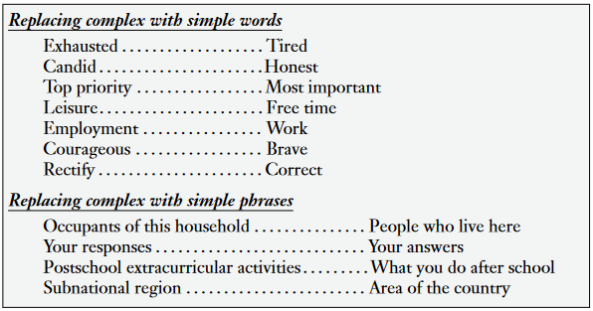
Use Simple and Familiar Words

Slide 20
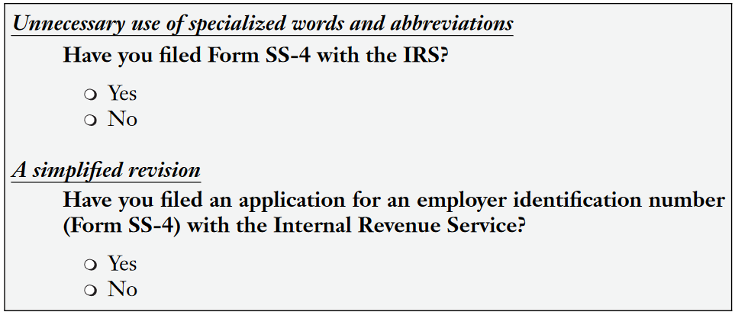
Use Simple and Familiar Words

Slide 21
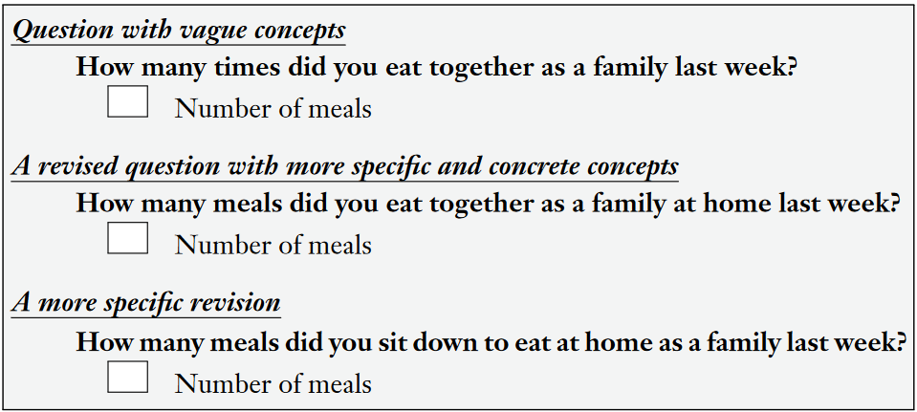
Use Specific and Concrete Words to Specify the Concepts Clearly

Slide 22
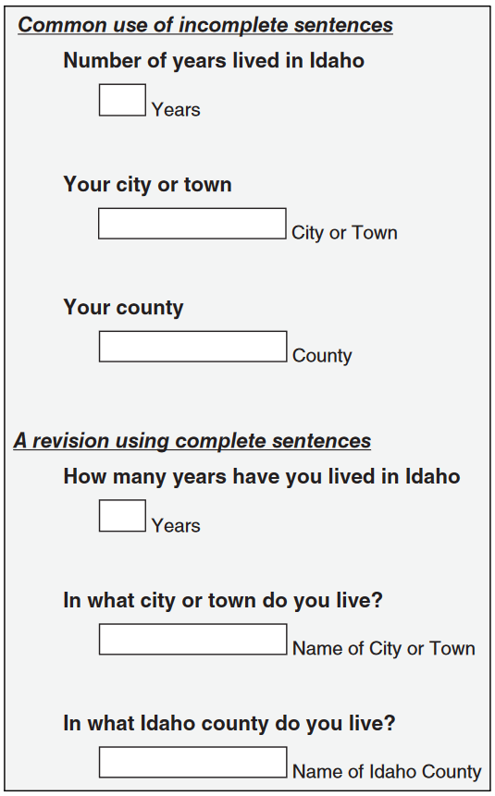
Use Complete Sentences That Take a Question Form, and Use Simple Sentence Structures
County vs. country

Slide 23
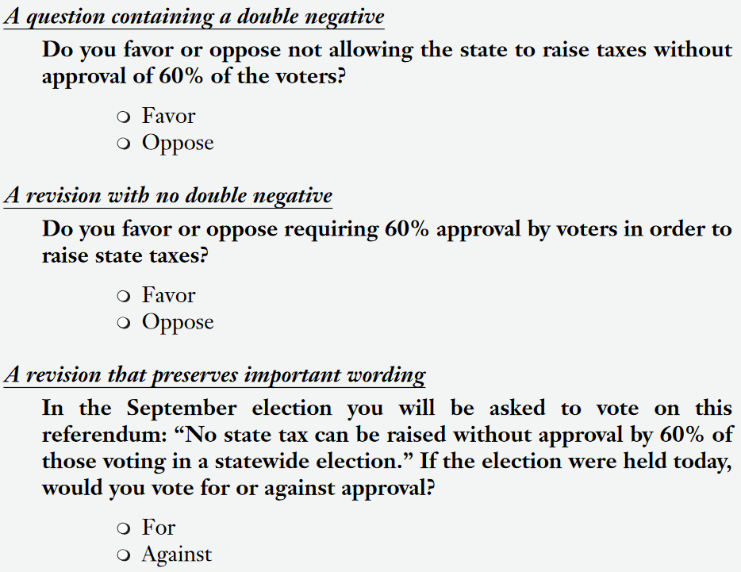
Make Sure “Yes” Means Yes and “No” Means No
Questions should not include double negatives, or, in other words, require a respondent to say “yes” to mean no

Slide 24
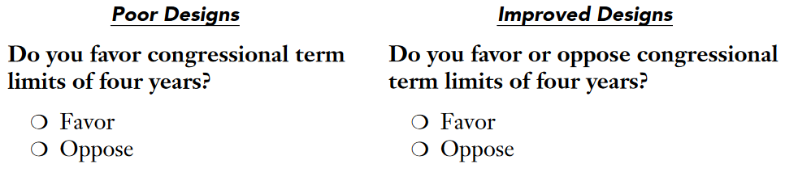
State both positive and negative sides in the question stem

Slide 25
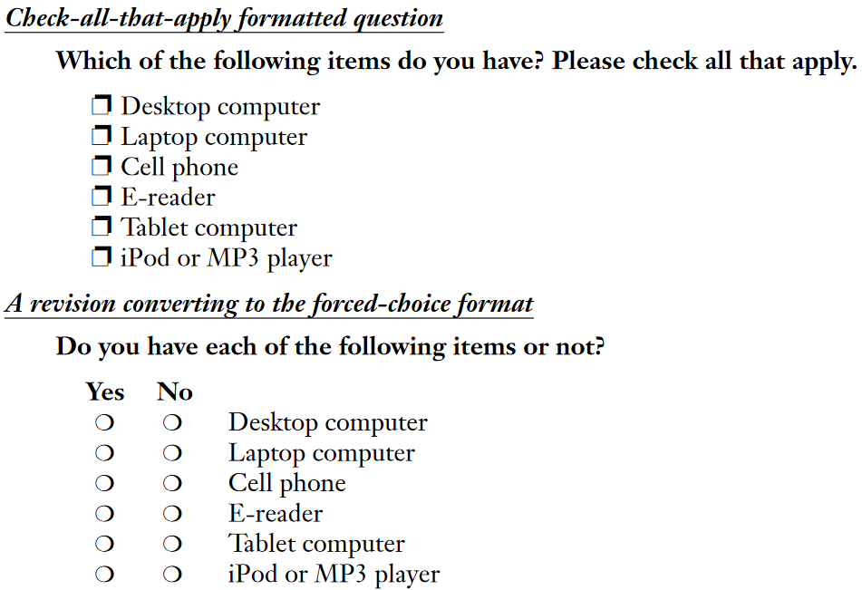
Check all that apply
Notes:
check-all format is prone to satisficing response strategies. They answered relatively quickly and were more likely to select the items appearing in the top half of the list than the bottom, regardless of what those items were (i.e., primacy). In contrast, respondents to the forced-choice format, even those who responded quite quickly, appeared to have processed all of the response options. Forced choice version is recommended.

Slide 26
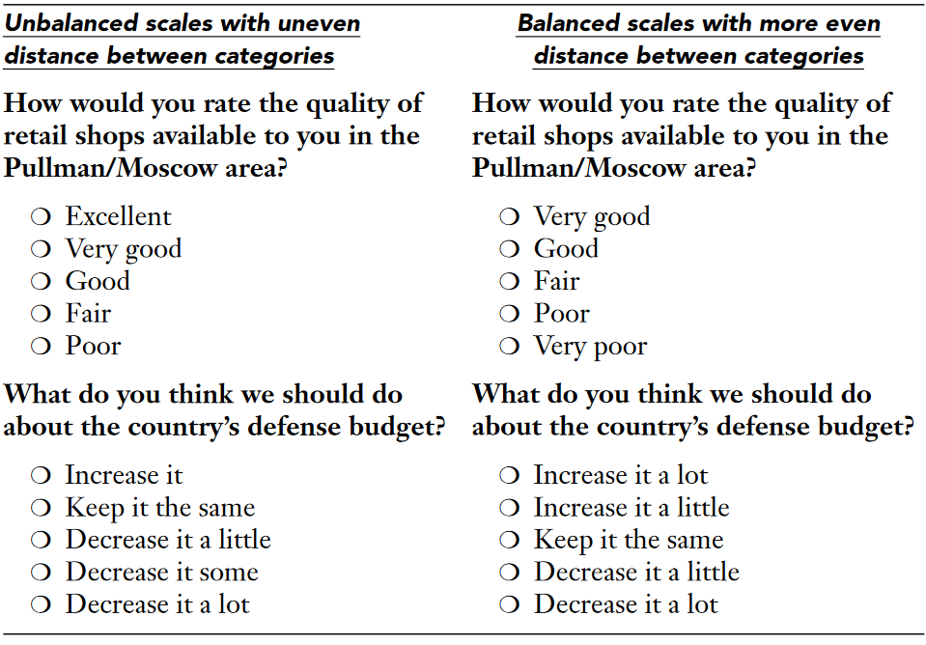
Provide balanced scales with categories that are evenly spaced conceptually

Slide 27
Use clear language that leads to only one interpretation
Can you name more famous measurement scholars than Ben Wright?
Two possible interpretations:
Can you name measurement scholars other than Ben Wright?
Can you name measurement scholars more famous than Ben Wright?
(use one of these instead)

Slide 28
Don’t make your respondents do math.
Calculations required:
About how many hours per month do you watch television on weekdays?
Better:
About how many hours per weekday do you spend watching television?

Slide 29
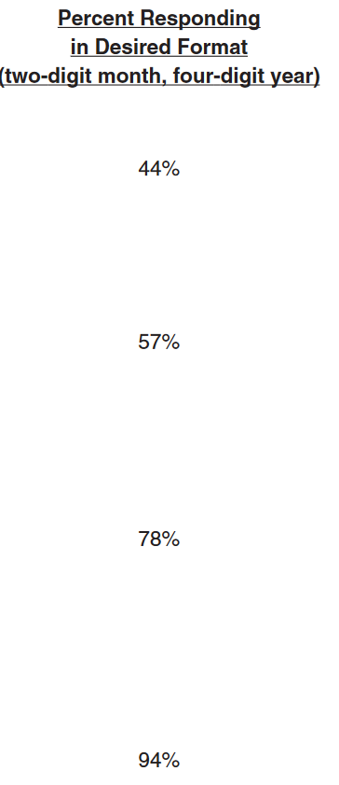
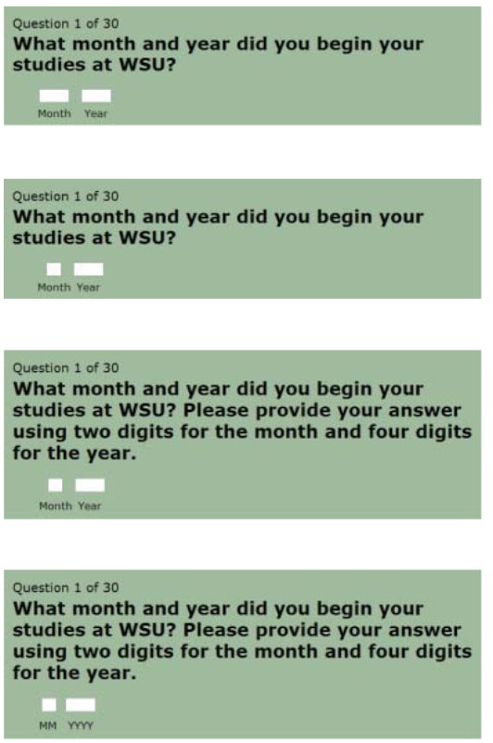
Visual Design Matters

Slide 30
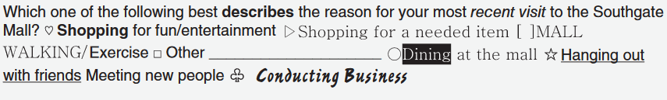
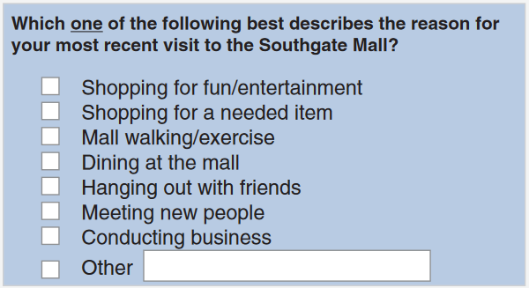
Visual Design Matters

Slide 31
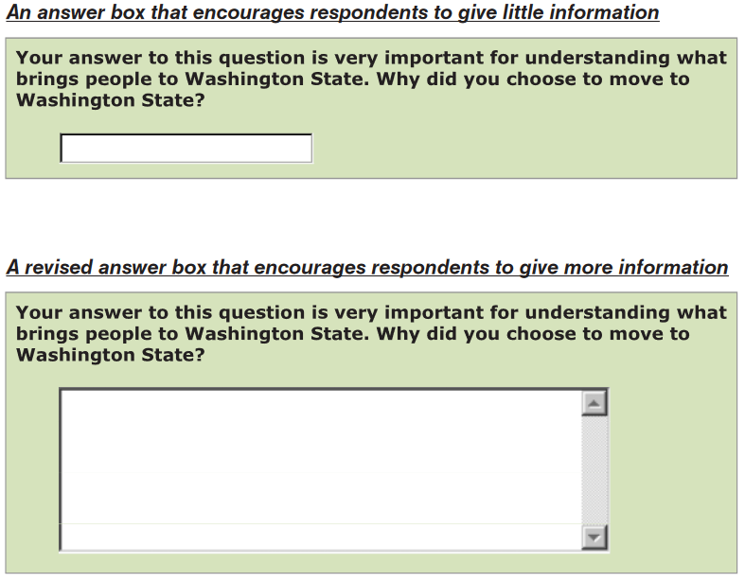
Visual Design Matters

Slide 32
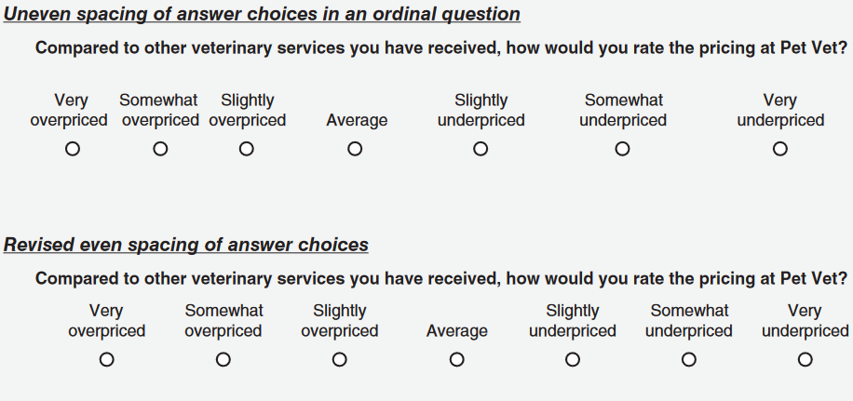
Visual Design Matters

Slide 33
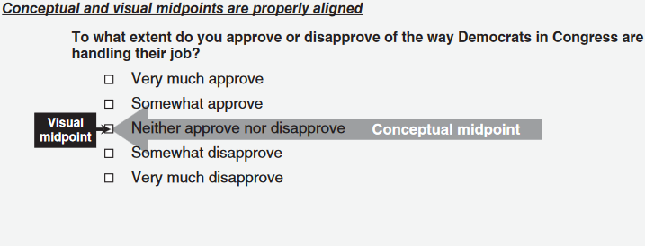
Visual Design Matters

Slide 34
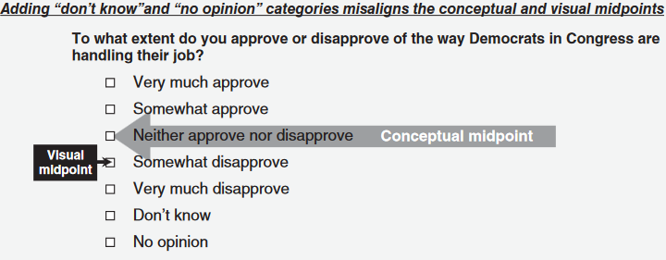
Visual Design Matters

Slide 35
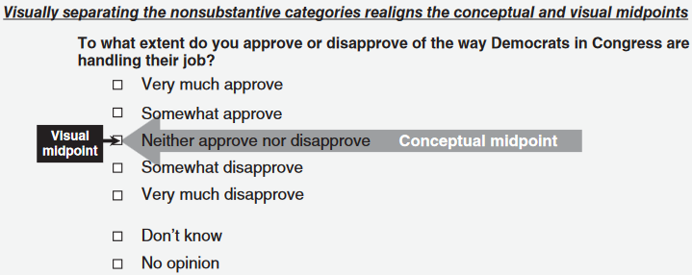
Visual Design Matters

Slide 36
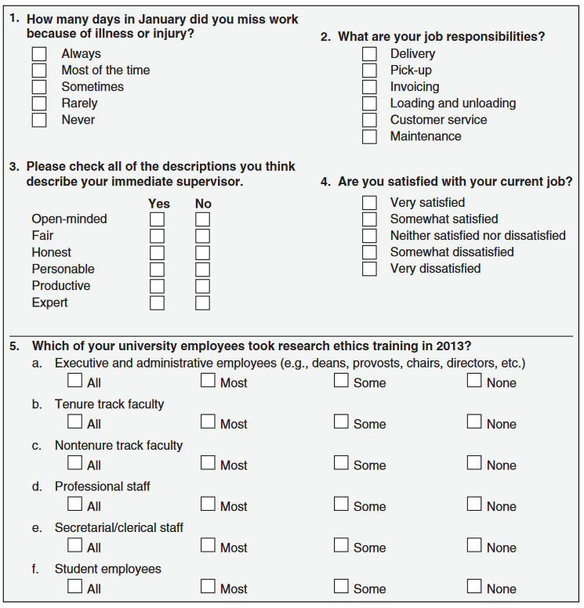
Exercise
Check if any of those items can be improved and, if yes, how.

